Slide 1
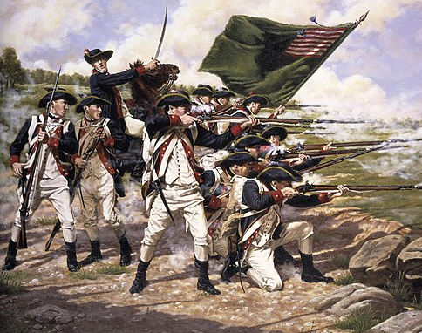
War and Independence
Part 9
The Early Years of War

Slide 2
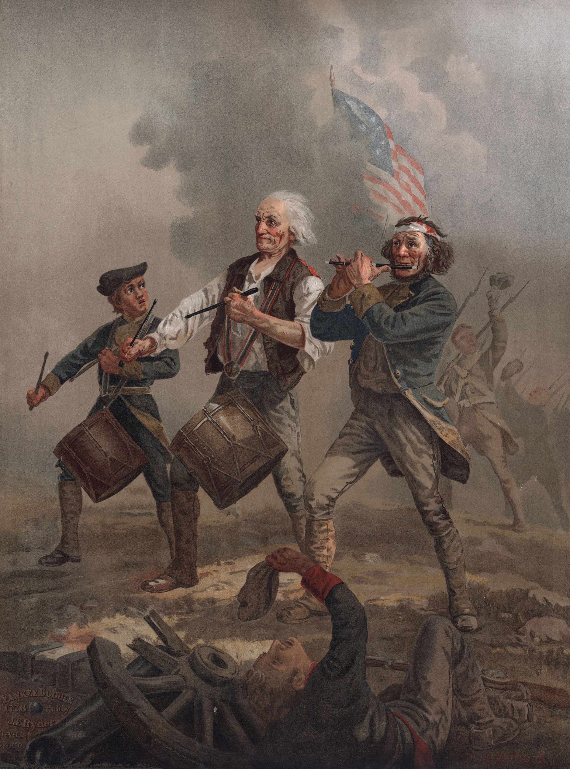
1. As you read, make a list of difficulties that the Patriots faced throughout the war.
-Only 2/5 of the population were Patriots.

Slide 3
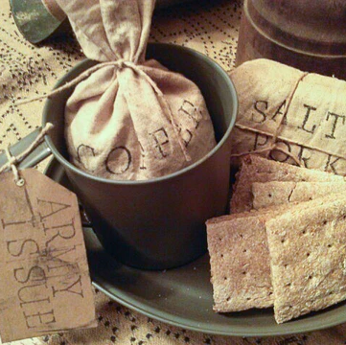
1. As you read, make a list of difficulties that the Patriots faced throughout the war.
-Shortages of supplies like food, clothing, shoes, blankets, tents, wagons, horses, soap, guns, gun powder and bullets.

Slide 4
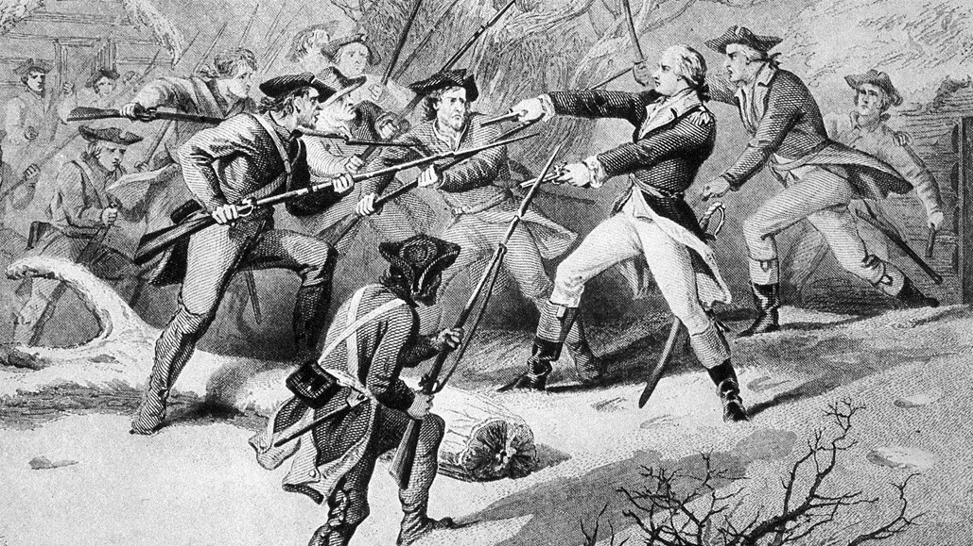
1. As you read, make a list of difficulties that the Patriots faced throughout the war.
-They fought against British soldiers, Hessian soldiers, Tories, and Native Americans.

Slide 5
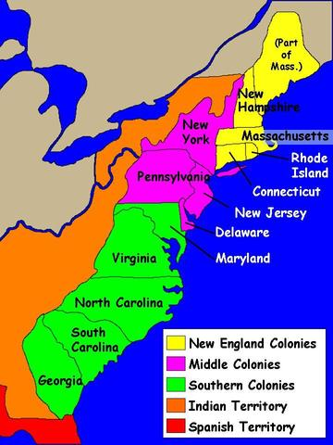
2. What colonies would you find the most patriots?
-New England colonies and Virginia.

Slide 6
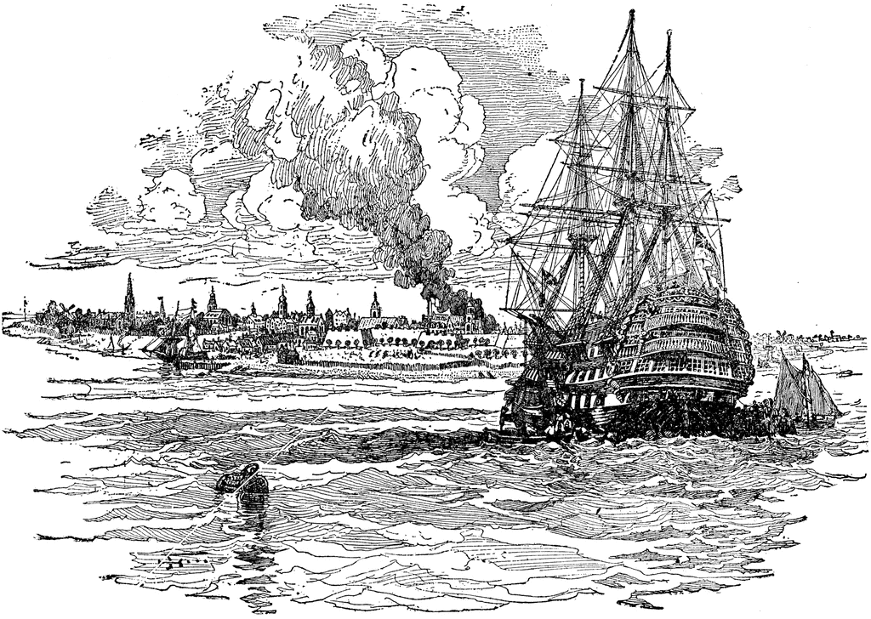
3. What colony had the most loyalists?
-New York

Slide 7
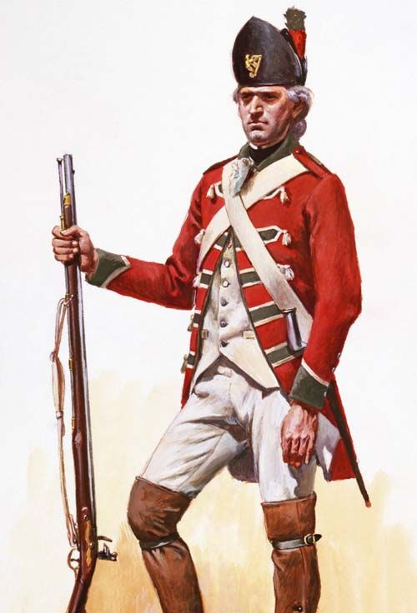
4. Why would a colonist be a loyalist?
-They were often employees of the British government or clergy of the Church of England.

Slide 8
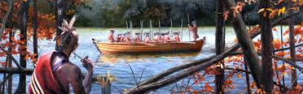
5. Which side of the conflict did most (not all) of the Native Americans take? Why?
The British. The Native Americans were afraid that if the Patriots won, they would be pushed further off their land.

Slide 9
6. How did the Continental Congress raise money to pay for things they needed to fight the war? What was the problem with this?
-They made paper money. It lost a lot of its value because Britain was able to pay for things with gold and silver. Soon people would not accept the paper money when selling things.

Slide 10
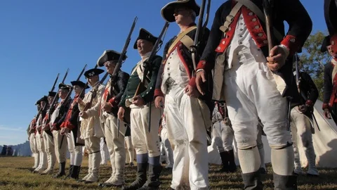
7. What helped convince some men to join the Continental army?
-They hoped to get land after the war, money, or social status.

Slide 11
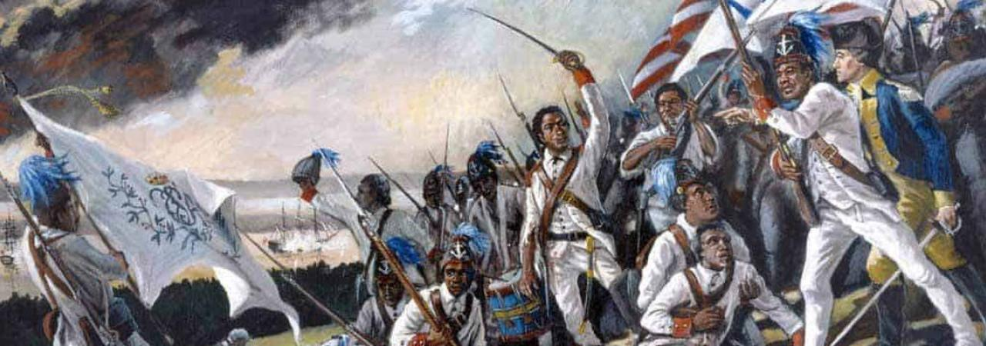
8. Why did Washington at first oppose African Americans joining the army? What changed his mind?
He, and others, were afraid that arming African Americans could threaten the slave system. He changed his mind when the British started to offer slaves their freedom if they fought for the king.

Slide 12
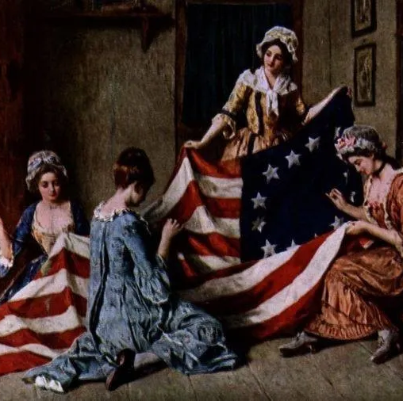
9. Give eight examples of what women did to help the Patriot cause?
-Women helped soldiers by washing clothes, cooking, cleaning, nursing, sewing and mending clothes. They also forced merchants to set fair prices.

Slide 13
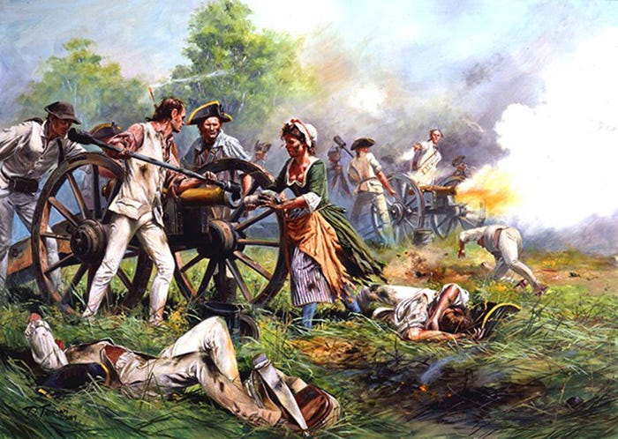
9. Give eight examples of what women did to help the Patriot cause?
-Some women even went out onto the battlefield to help the soldiers.

Slide 14
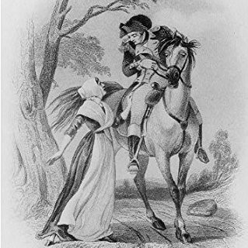
9. Give eight examples of what women did to help the Patriot cause?
-Daring women acted as spies for the Patriots.

Slide 15
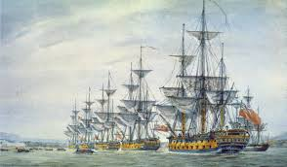
After Boston, the British army fled to Nova Scotia to recuperate. The British then arrived in New York harbor in July of 1776 and attacked Washington’s forces.
10. After the British left Boston, where did they eventually end up going?

Slide 16
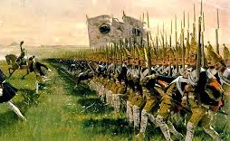
11. Who are Hessian soldiers?
Hessian soldiers are professional soldiers from what is now Germany hired by the British to help fight against the Patriots.

Slide 17
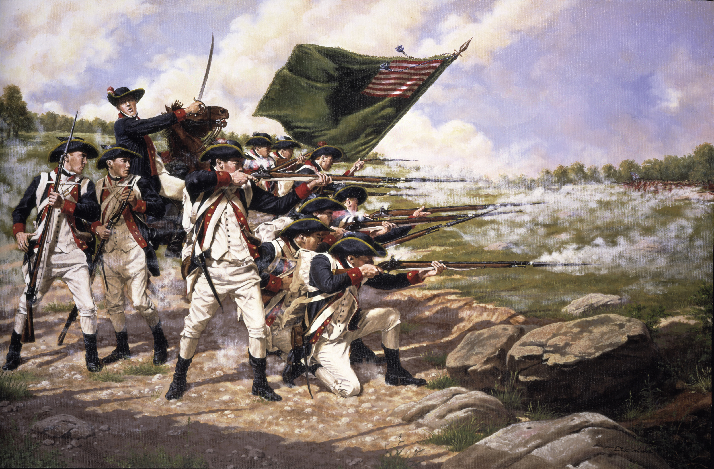
12. Over the summer of 1776, the British and Americans fought for New York. Who ended up winning?
-The British beat the Continental army and took over New York City.

Slide 18
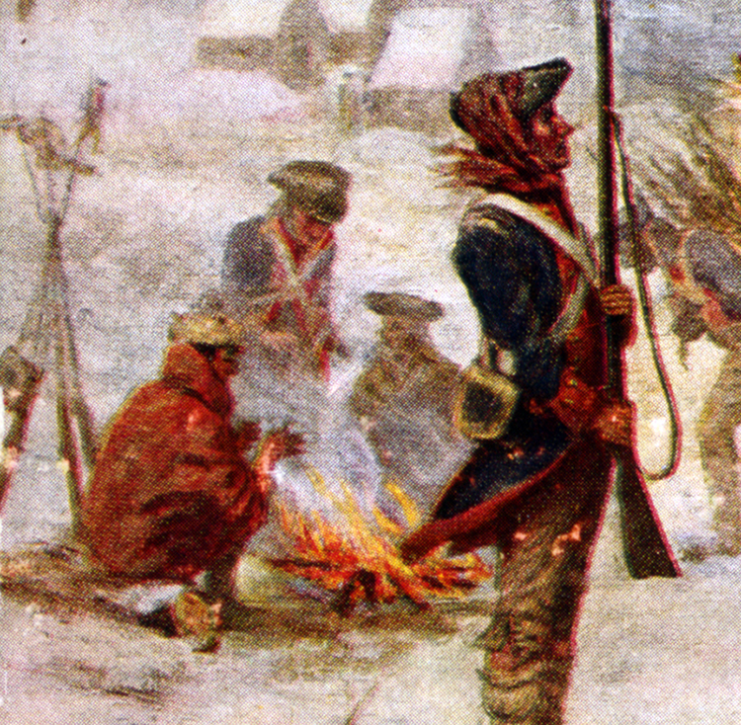
13. What happened to Washington’s army during the beginning of the winter of 1776-1777?
The army almost fell apart. It went from 20,000 soldiers to a few thousand. Many soldiers just went home.

Slide 19
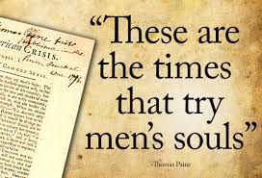
14. How did Thomas Paine help the Patriot cause?
-He wrote a series of pamphlets called The Crisis. It encouraged many Patriots to not give up and fight for independence from British rule.

Slide 20
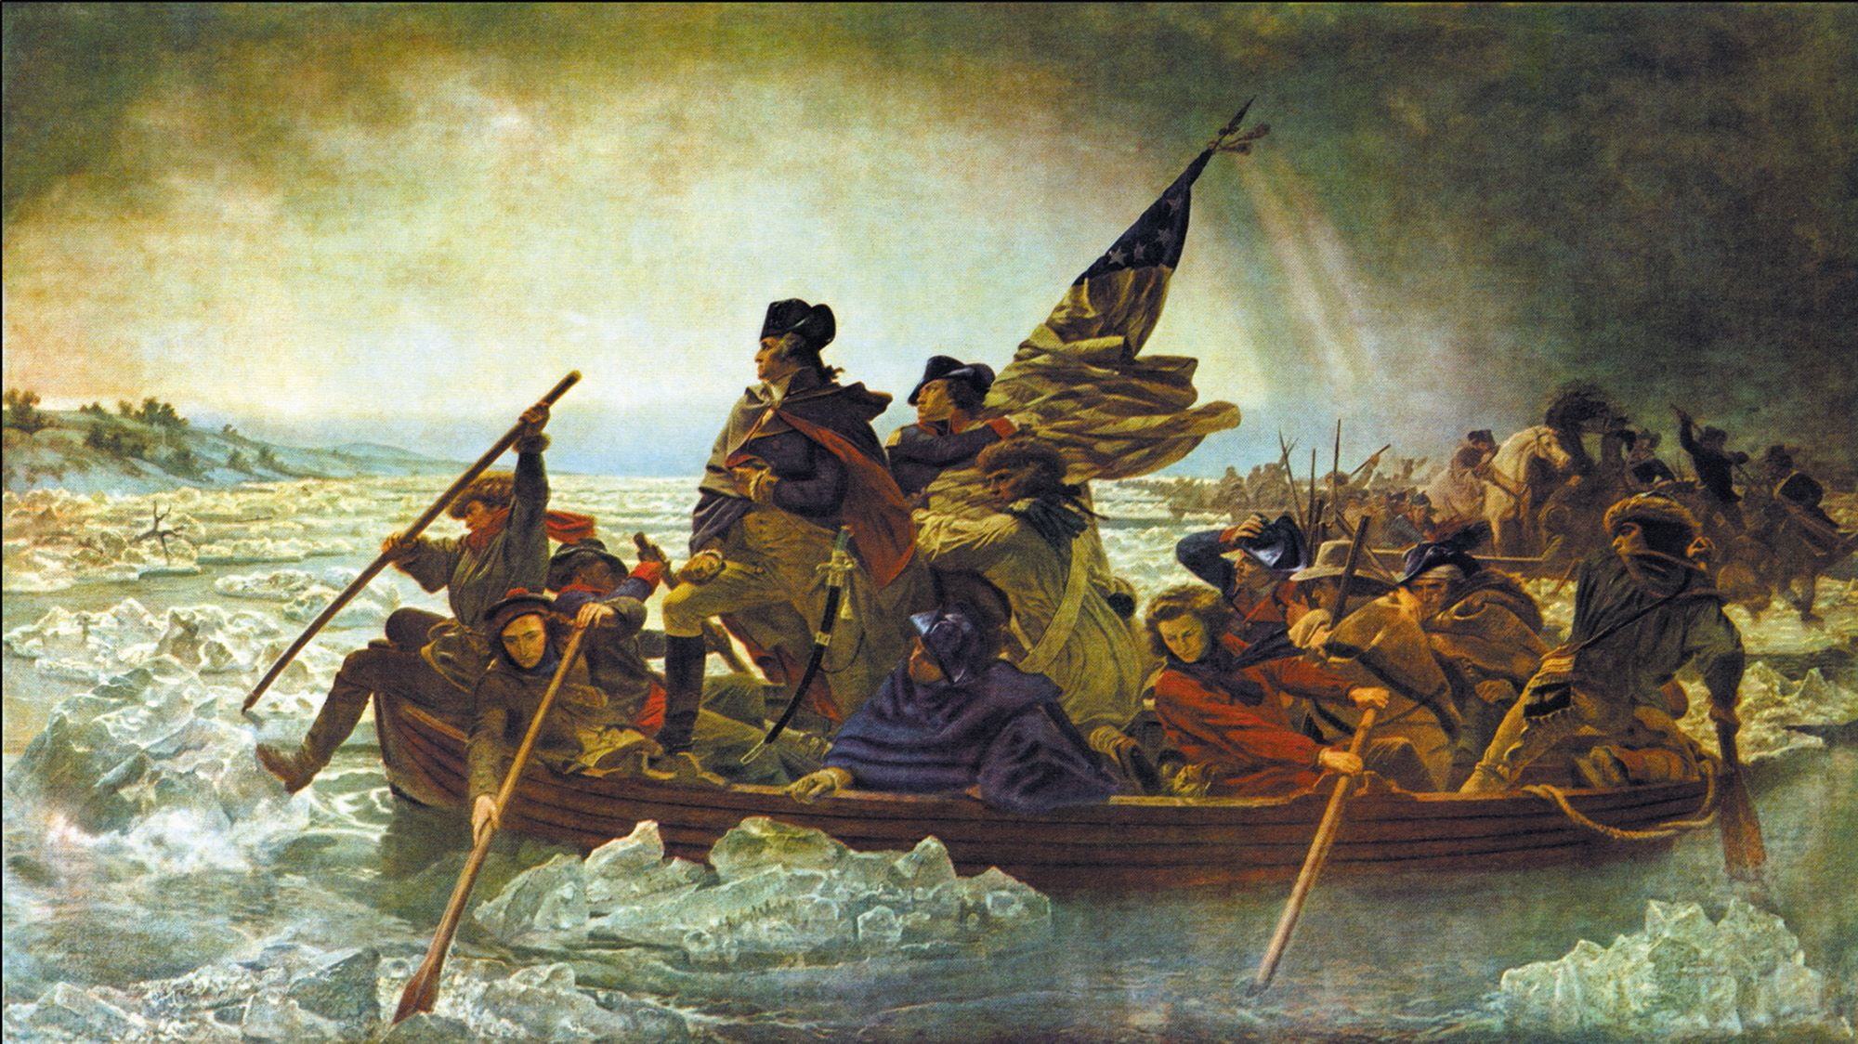
15. What risk did Washington take on Christmas night of 1776? How did it turn out?
He secretly rowed his army across the icy Delaware River to attack the Hessian soldiers staying in Trenton, NJ. The Continental Army won a huge victory!

Slide 21
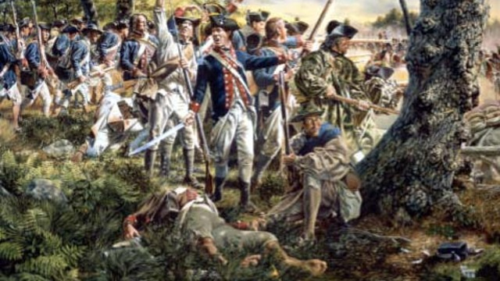
16. What happened to Philadelphia in the fall of 1777?
-The British captured the city.

Slide 22
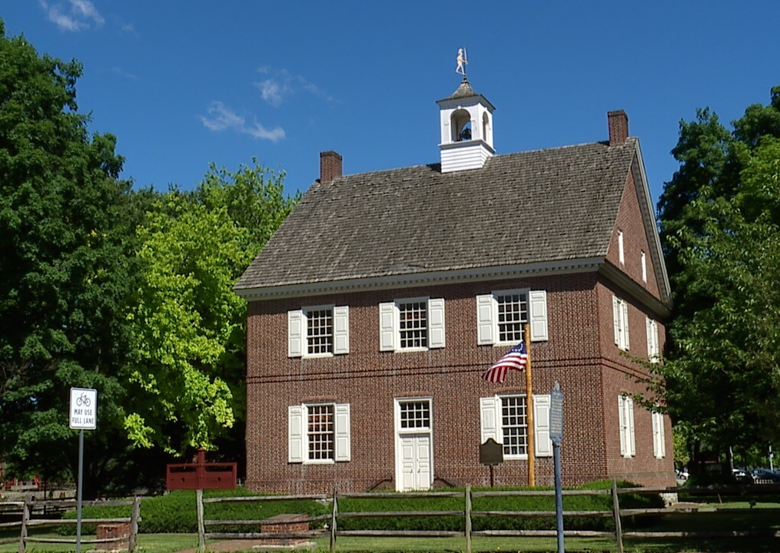
17. What did the Continental Congress do?
-The Continental Congress fled to York, PA.

Slide 23
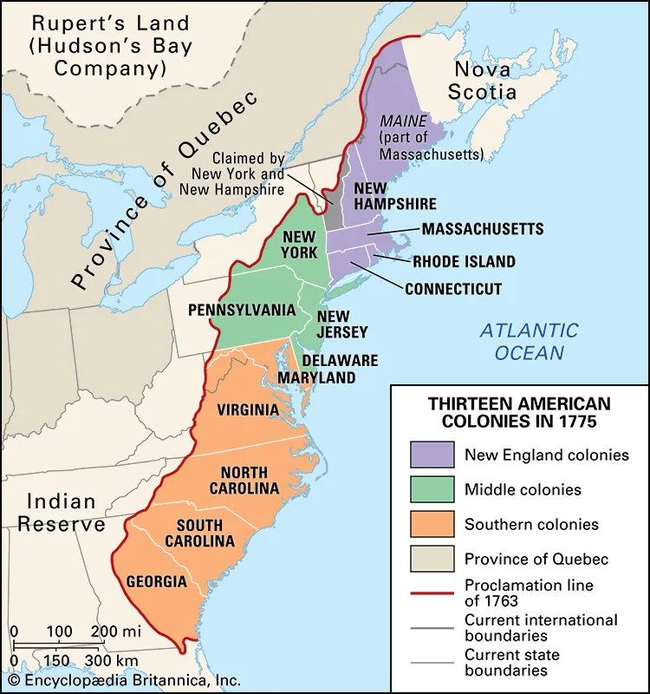
18. What did the British think they could do if they took control of the Hudson River valley?
-Divide the colonies in two by isolating New England.

Slide 24
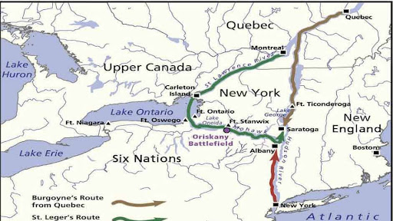

Slide 25
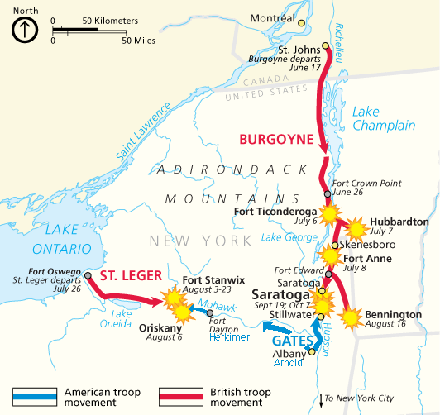
19. Why didn’t their strategy in the Hudson River valley work?
-Three British armies were supposed to meet up at Albany. It never worked out for them.

Slide 26
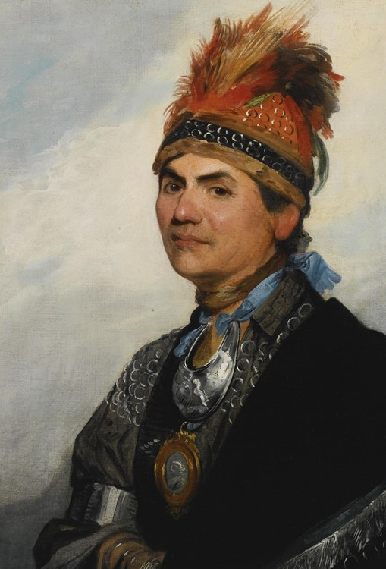
20. Who was the Mohawk chief who fought for the British?
-Joseph Brant

Slide 27
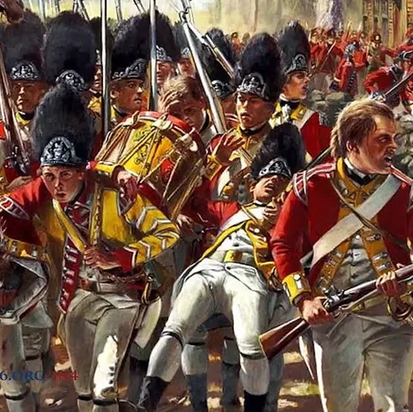
21. What happened at Freeman’s Farm?
Benedict Arnold led the Continental army in stopping General Burgoyne and the British army from breaking through the Continentals’ earthworks. The British retreated.

Slide 28
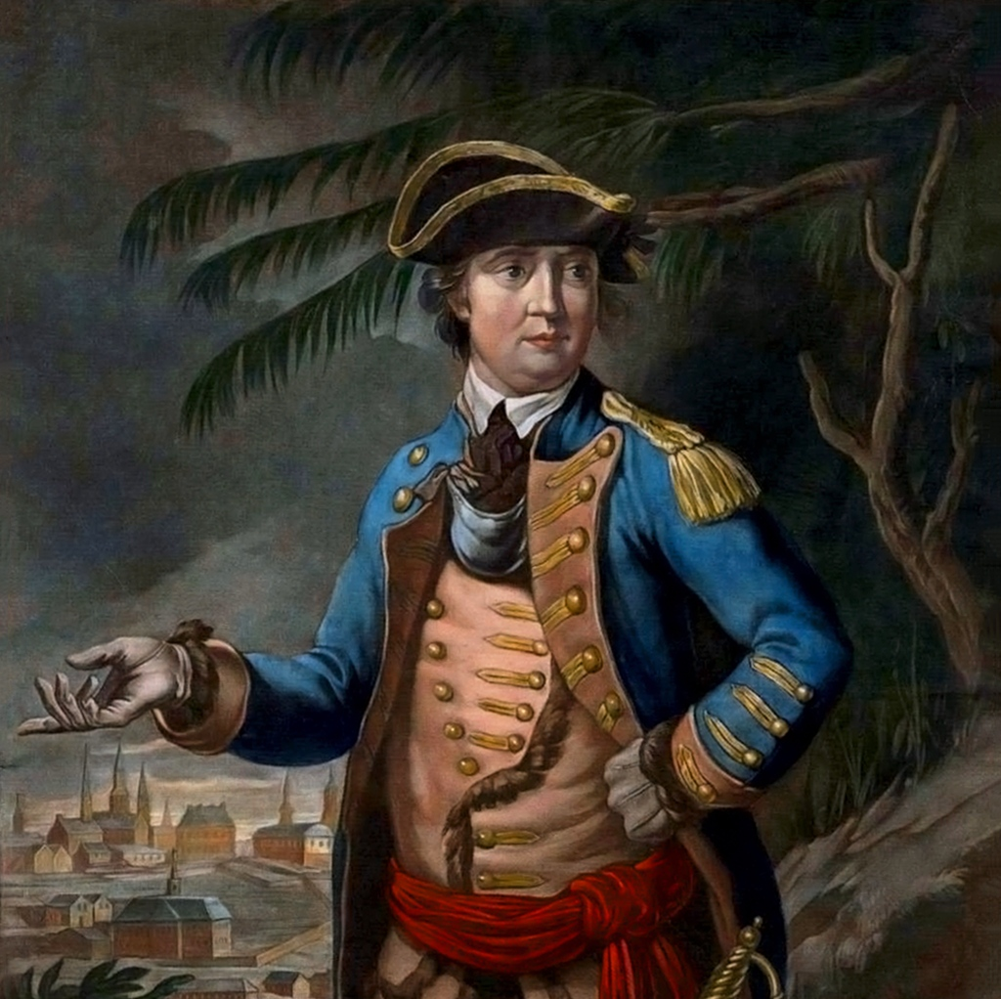
22. What did Benedict Arnold do in 1780? Why?
He turned traitor and joined the British because he was mad for not getting credit for all his success in the war for the Patriots.

Slide 29
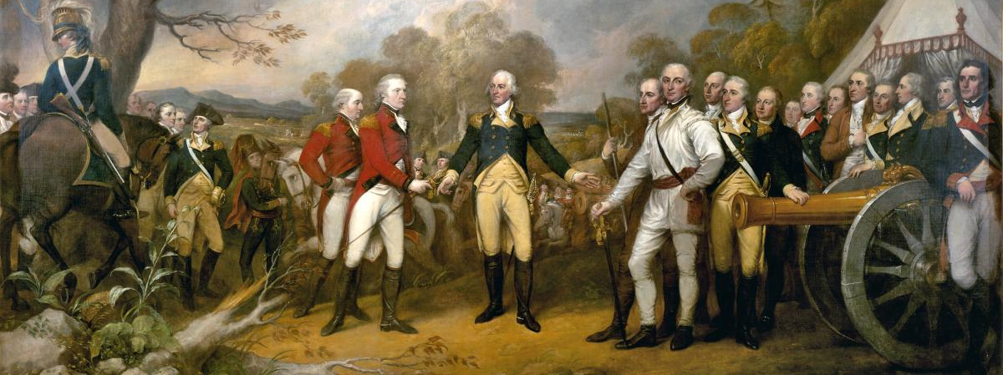
23. Why was the Battle of Saratoga important?
It showed that the Patriots could win which convinced France and Spain to join the Patriots in the war.

